Slide 1


What makes a
video trending or viral?
An insight into the features of and factors behind such phenomena
Group 11: George Linel, Jorge Perez, Elisa Valentin, Philippine Coutau, Carla Barleaza
GitHub : https://github.com/carlabarleaza/QM-groupwork
Notes:
Context:
Our project stems from this simple observation: everyone watches Youtube, and we’re all rather familiar with the idea of viral videos
YouTube is one of the most successful platforms for visual entertainment ever.
With no requirements for uploading, there are thousands of videos uploaded every day surrounding thousands of different themes. Because of this, the phenomenon of viral videos arose with certain uploads reaching millions of views in a matter of minutes. Though one would expect trending to go hand in hand with viral, it has been found that the trending page doesn’t always show the viral videos.
Our research questions and What we aim to explore through our project: what makes a Youtube video go viral, or trending?
For this, we want to investigate the features of viral videos in the rise of internet and YouTube (as early as 2006) and the features of trending videos more recently (2017 onwards). We will compare the results, chronologically and geographically in order to identify potential patterns that contribute to make a video trending or viral.

Slide 2
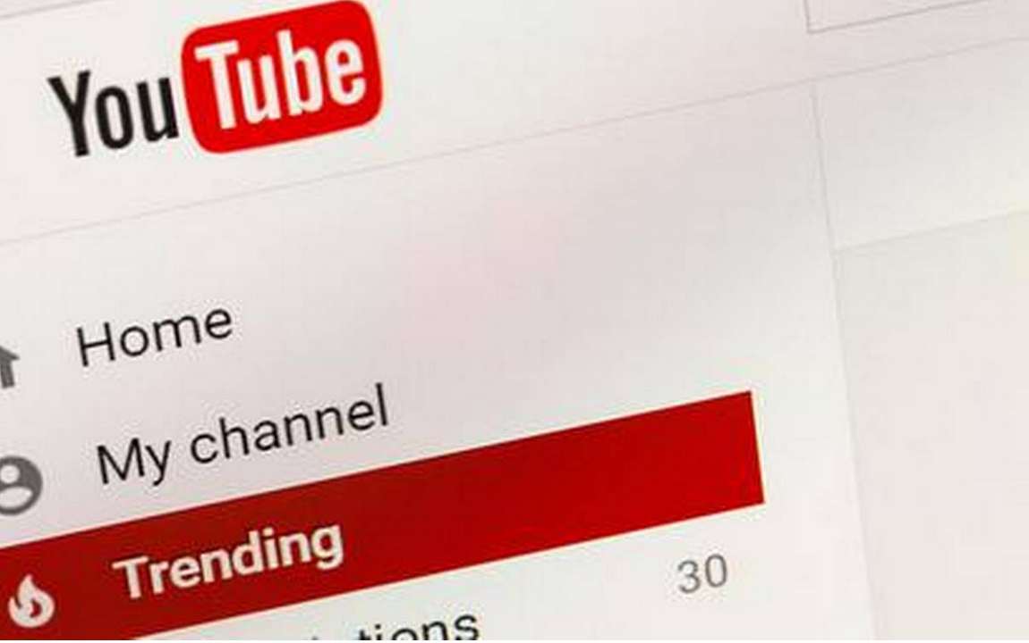
What is Youtube Trending ?
https://www.youtube.com/feed/trending
Youtube’s algorithm selects a range of videos users would find interesting
Videos that have the potential of becoming popular
Several criteria (eg. : view count, age of the video)
Frequently updated (roughly every 15 mn)
Tailored to each region of the world
Notes:
https://support.google.com/youtube/answer/7239739?hl=en-GB
Barjasteh, I., Liu, Y., & Radha, H. (2014). Trending videos: Measurement and analysis. arXiv preprint arXiv:1409.7733.
According to Variety magazine, “To determine the year’s top-trending videos, YouTube uses a combination of factors including measuring users interactions (number of views, shares, comments and likes). Note that they’re not the most-viewed videos overall for the calendar year”. (kaggle)

Slide 3


Trending
What we know:
What we don't know:
Rate of increase in views
Official channels
Success of videos in short term
Advertiser friendly
Time of publication
Like to dislike ratio

Slide 4

What does it mean to go viral?
How a piece of content can spread just like a virus? - “social epidemics” (Moreau, 2020) .
Create content that is shared exponentially online
Spreads very quickly and very widely
Passed contagiously - excessively shared
“A video ‘going viral’ requires a combination of shock value, uniqueness, and unexpectedness” (Codega, 2020).
When is your video considered gone viral?
There are no guarantees or exact statistics for going viral (Wynne, 2018)
There isn’t exact criterias to define a viral video. Some analyst argue it is purely the rate at which the content is consumed while others argue it could be the amount of views (it ranges from a 100.000 to 5 million views) (Staff, 2019).
Notes:
What does going viral means?
We can compare a viral video to a virus illess that can easily be spreads from a person to another around the world. Some call this kind of content “social epidemics”. Going viral is when a person upload content like a video or a tweet on social media and it gets excessively shared. The infection usually comes from evoked emotions that spur the viewer to share it, so they can relate with other people and discuss how they feel about it. “A video ‘going viral’ requires a combination of shock value, uniqueness, and unexpectedness”. For now, experts haven’t found yet the ‘recipe’ to go viral on youtube there are no guarantees or exact statistics. When is your video considered gone viral ? There isn’t exact criterias to define a viral video. Some analyst argue it is purely the rate at which the content is consumed while others argue it could be the amount of views (it ranges from a 100.000 to 5 million views).

Slide 5

Viral
What we know:
What we don't:
High view count
Some categories are more likely to go viral
Does timing affect it?
Ease of going viral
Start of Youtube v/s Later years
Small or large channels?

Slide 6
What we did

Slide 7

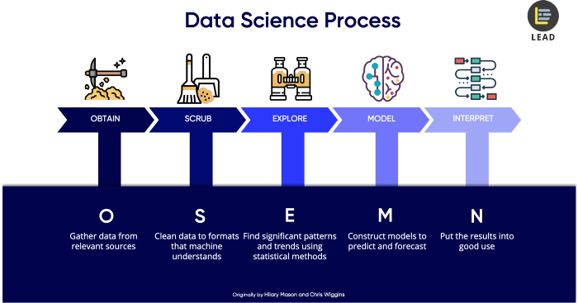
Aims
Research
→ Obtain insights that can be useful to people wanting to increase the popularity of their Youtube videos
In depth statistical analysis of Trending Videos:
Categories of content
Length of videos
Correlation of variables (likes, dislikes, views, tags, description)
Debunking the Youtube Trending algorithm
a) how different this is to the viral videos phenomenon
b) how the selection of trending videos changed through time, and geographically
c) Comparing Trending v/s Viral Videos
Step 1: Brainstorm a topic
Step 2: Formulate research questions, hypothesis, what we aim to achieve
Adapted from the O.S.E.M.N. framework
Notes:
Obtain insights that can be useful to people wanting to increase the popularity of their Youtube videos.

Slide 8
https://www.kaggle.com/datasnaek/youtube-new
https://sites.google.com/site/cmuviralvideos/download
Research
Follows the YouTube videos on the trending page for 2017-2018 for 10 countries (Brazil, Denmark, France, Great Britain, japan, India, Korea, Russia, Canada and Mexico)
Step 1: Brainstorm a topic
Step 2: Formulate a research question and hypothesis
Step 3: Gather the data
(Kaggle datasets)
Carnegie Mellon following viral videos from 2006- 2011. This will be used to see how the topic of viral videos changes as internet and YouTube availability changes.
Dataset regarding internet availability from 1990 to 2017https://ourworldindata.org/internet#:~:text=Globally%20the%20number%20of%20internet,from%20each%20country%20are%20online%3F
Notes:
After finding our research question we gathered data. Our analysis will be based off 3 datasets
We first found data that Follows the YouTube videos on the trending page for 2017-2018 for 10 countries (Brazil, Denmark, France, Great Britain, japan, India, Korea, Russia, Canada and Mexico) on a website called kaggle where we found information such as trending date title, category_id, publish_time, tags, views, likes dislikes which will help us later to see if there is a correlation or not between those factors.
In a second time, we found one data set regarding internet availability from 1990 to 2017 and another one where Carnegie Mellon follows viral videos from 2006-2011. This will be used to see how the topic of viral videos changes as internet and Ytb availability changes.
Source: https://towardsdatascience.com/5-steps-of-a-data-science-project-lifecycle-26c50372b492
In this process, you need to convert the data from one format to another and consolidate everything into one standardized format across all data. For example, if your data is stored in multiple CSV files, then you will consolidate these CSV data into a single repository, so that you can process and analyze it.
On top of that, scrubbing data also includes the task of extracting and replacing values. If you realise there are missing data sets or they could appear to be non-values, this is the time to replace them accordingly.
Lastly, you will also need to split, merge and extract columns
data visualisation to help us to identify significant patterns and trends in our data

Slide 9
Literature Review
What others have done before us
Increasing amount of research has been done around popularity on Youtube
Viral and trending phenomena usually analysed separately
Datasets mostly collected through Youtube API
Jiang, Lu, et al. "Viral video style: A closer look at viral videos on youtube." Proceedings of International Conference on Multimedia Retrieval. 2014. CMU Viral Videos Dataset
Hussain, Muhammad Nihal, et al. "Understanding digital ethnography: socio-computational analysis of trending YouTube videos." International Conference on Social Computing, Behavioral-Cultural Modeling & Prediction and Behavior Representation in Modeling and Simulation (SBP-BRiMS 2018). 2018. Kaggle Youtube Trending Statistics Dataset

Slide 10
The Next Steps

Slide 11
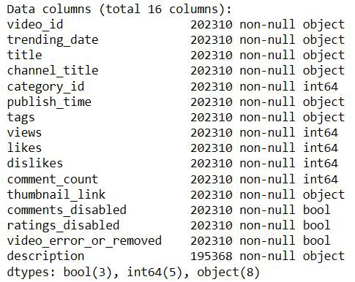
Research
Scrub
Step 1: Brainstorm a topic
Step 2: Gather the data
(YouTube API, Kaggle datasets)
Step 3: Formulate a research question and hypothesis
Step 4: Initial research for existing literature
Step 1: Standardise the format across all data
Step 2: (if applicable) merge the datasets
and clean data
Features of the ‘Trending YouTube Video Statistics’ dataset
Notes:
Source: https://towardsdatascience.com/5-steps-of-a-data-science-project-lifecycle-26c50372b492
In this process, you need to convert the data from one format to another and consolidate everything into one standardized format across all data. For example, if your data is stored in multiple CSV files, then you will consolidate these CSV data into a single repository, so that you can process and analyze it.
On top of that, scrubbing data also includes the task of extracting and replacing values. If you realise there are missing data sets or they could appear to be non-values, this is the time to replace them accordingly.
Lastly, you will also need to split, merge and extract columns
data visualisation to help us to identify significant patterns and trends in our data

Slide 12
What we will do
Explore
Step 1: First exploration of data, refine the research question and hypothesis
Step 2: Extract features and test significant variables (EDA and through correlation)
Step 3: Using statistical methods, manipulate and transform the data to find significant patterns and trends
Step 4: Visualise the data
Notes:
Source: https://towardsdatascience.com/5-steps-of-a-data-science-project-lifecycle-26c50372b492
In this process, you need to convert the data from one format to another and consolidate everything into one standardized format across all data. For example, if your data is stored in multiple CSV files, then you will consolidate these CSV data into a single repository, so that you can process and analyze it.
On top of that, scrubbing data also includes the task of extracting and replacing values. If you realise there are missing data sets or they could appear to be non-values, this is the time to replace them accordingly.
Lastly, you will also need to split, merge and extract columns
data visualisation to help us to identify significant patterns and trends in our data

Slide 13

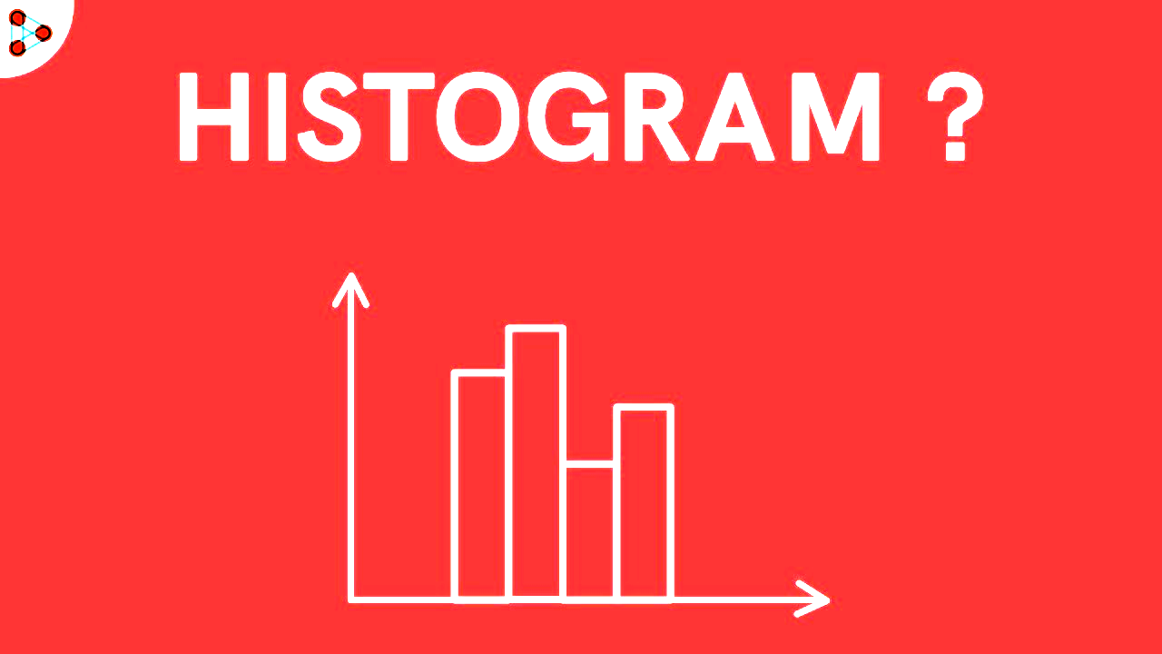
Exploratory Data Analysis
Which categories have the most number of trending videos? the most likes? the most views?
How often does a category go viral?
What is the most used word in the title of trending & viral videos
1. Identifying outliers, missing values.
2. Understanding the relationship between variables
3. Separating important variables and leaving behind useless variables
Notes:
Would allow us to identify, which categories have the most likes, the most views.
Good way to visualize the difference in frequency

Slide 14
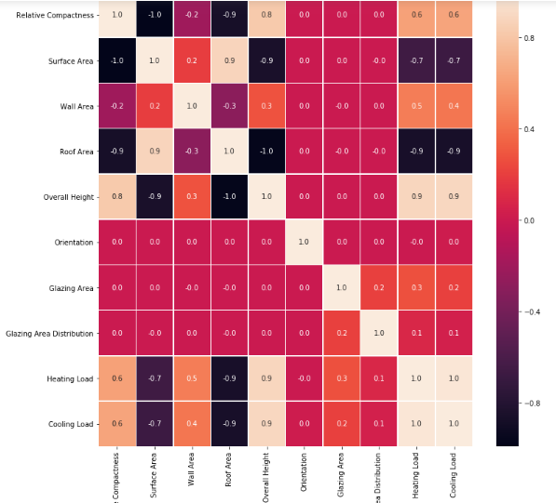
Correlation heatmap
→ to evaluate and visualise the correlation between the different metrics of trending videos
i.e. title length/views, views/comments
https://i.stack.imgur.com/QRhFU.png

Slide 15
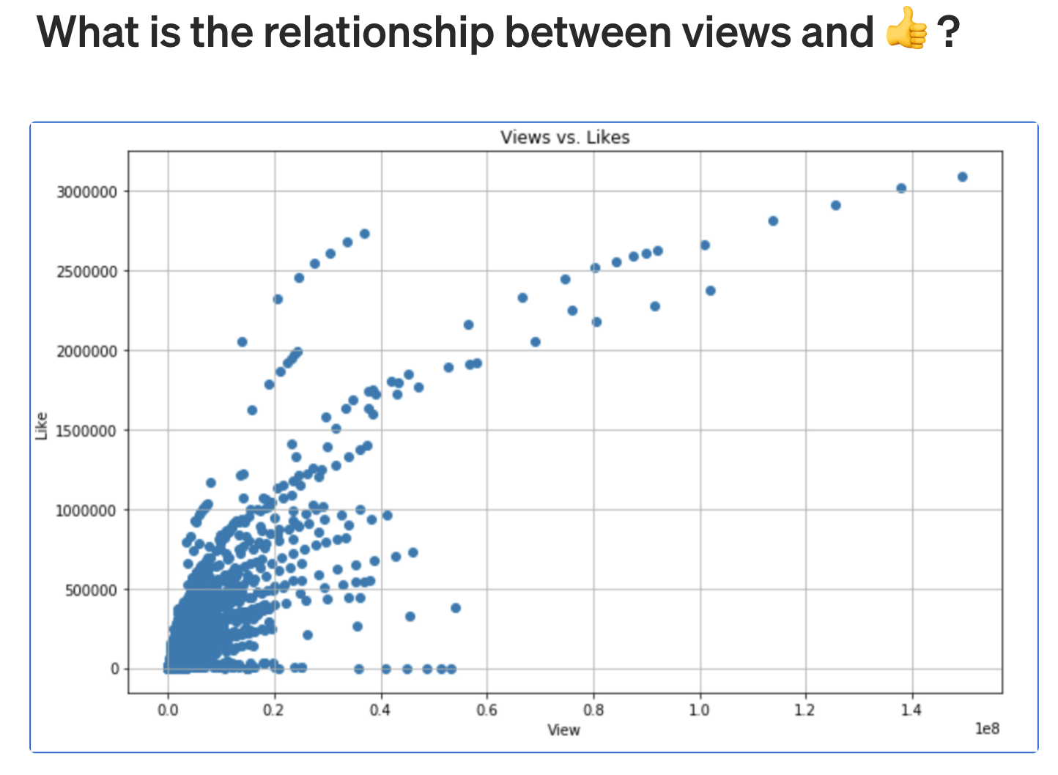
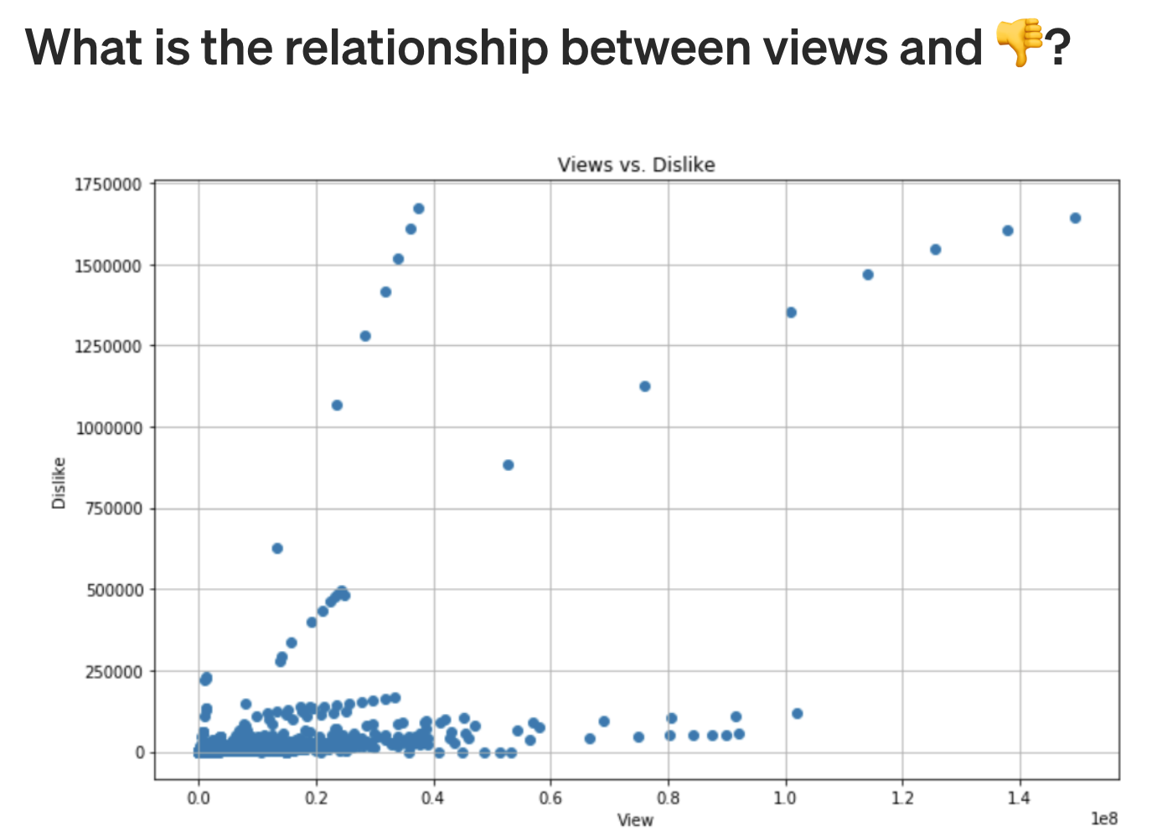
Scatter plots
→ to visualise the relationship between views/likes & views/dislikes

Slide 16
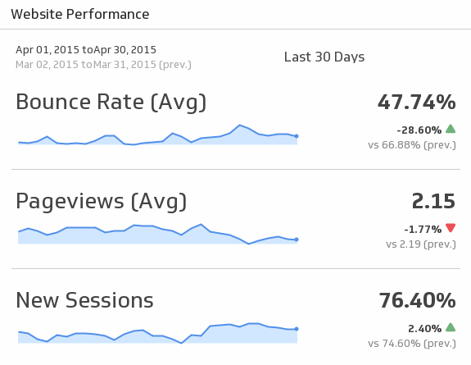
Sparkline
→ To look at peak year for categories (2006-2011)

Slide 17
Adapted from the O.S.E.M.N. framework
Research
Scrub
Explore
Model
Step 1: Brainstorm a topic
Step 2: Gather the data
(YouTube API, Kaggle datasets)
Step 3: Formulate a research question and hypothesis
Step 4: Initial research for existing literature
Step 1: Standardise the format across all data
Step 2: (if applicable) merge the datasets
and clean data
Step 1: First exploration of data, refine the research question and hypothesis
Step 2: Extract features and test significant variables (through correlation)
Step 3: Using statistical methods, manipulate and transform the data to find significant patterns and trends
Step 4: Visualise the data (charts like bar charts)
Step 1: Reduce the dimensionality of the data set
Step 2: Model the likeliness that a video goes trending through a probabilities tree, based on factors previously analysed (title length, tags, description, …)
Medium. 2020. 5 Steps Of A Data Science Project Lifecycle. [online] Available at: <https://towardsdatascience.com/5-steps-of-a-data-science-project-lifecycle-26c50372b492> [Accessed 16 November 2020].
Notes:
Source: https://towardsdatascience.com/5-steps-of-a-data-science-project-lifecycle-26c50372b492

Slide 18
Adapted from the O.S.E.M.N. framework
Research
Scrub
Explore
Model
Communicate
Step 1: Brainstorm a topic
Step 2: Gather the data
(YouTube API, Kaggle datasets)
Step 3: Formulate a research question and hypothesis
Step 4: Initial research for existing literature
Step 1: Standardise the format across all data
Step 2: (if applicable) merge the datasets
and clean data
Step 1: First exploration of data, refine the research question and hypothesis
Step 2: Extract features and test significant variables (through correlation)
Step 3: Using statistical methods, manipulate and transform the data to find significant patterns and trends
Step 4: Visualise the data
Step 1: Answer research question
Step 2: Communicate our results through visual representations and storytelling
Step 1: Reduce the dimensionality of the data set
Step 2: Model the likeliness that a video goes trending through a probabilities tree, based on factors previously analysed (title length, tags, description, …)
Medium. 2020. 5 Steps Of A Data Science Project Lifecycle. [online] Available at: <https://towardsdatascience.com/5-steps-of-a-data-science-project-lifecycle-26c50372b492> [Accessed 16 November 2020].
Notes:
Source: https://towardsdatascience.com/5-steps-of-a-data-science-project-lifecycle-26c50372b492

Slide 19
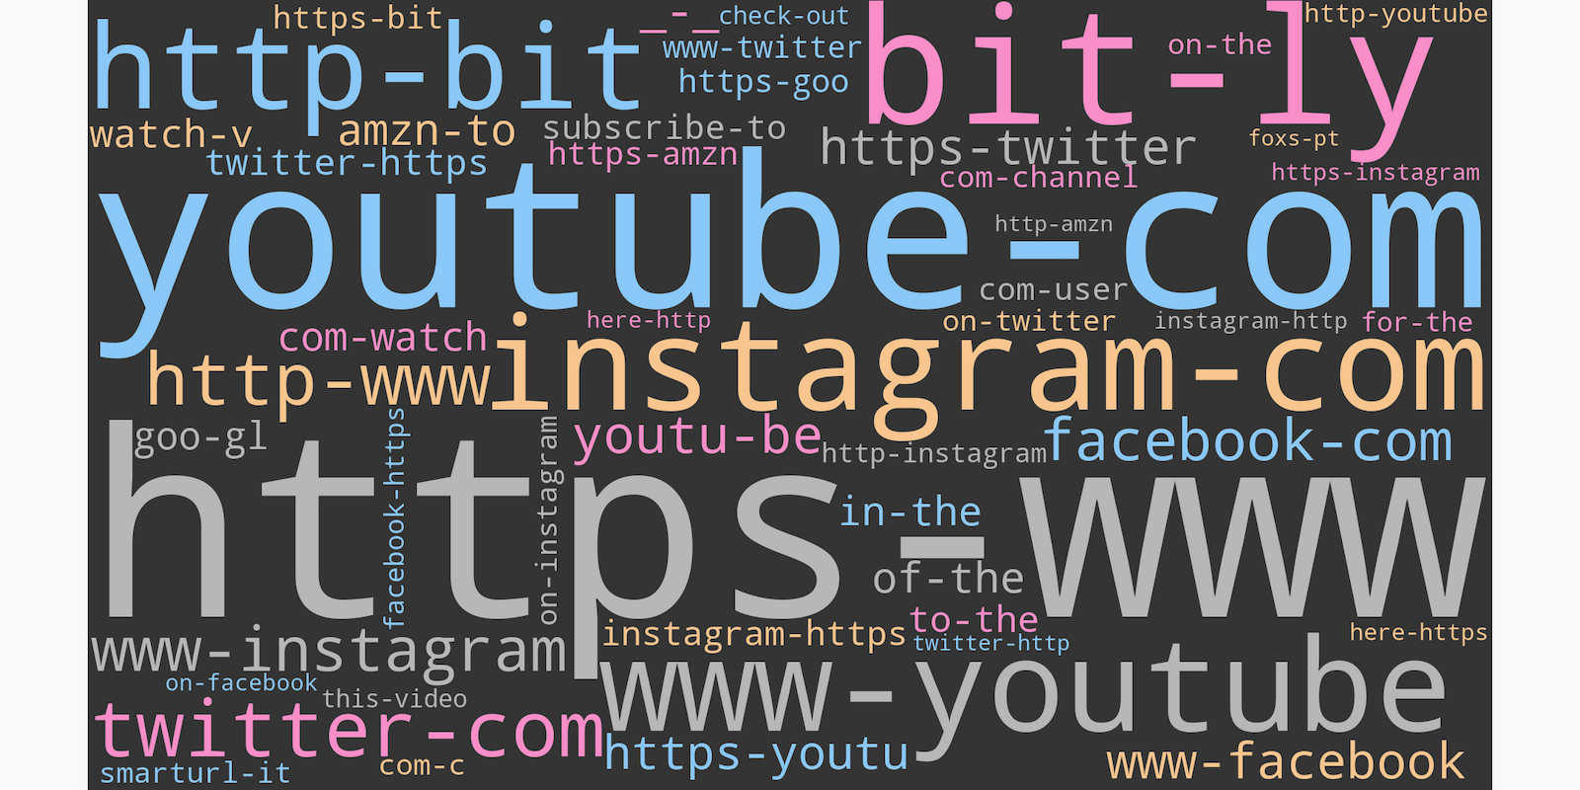
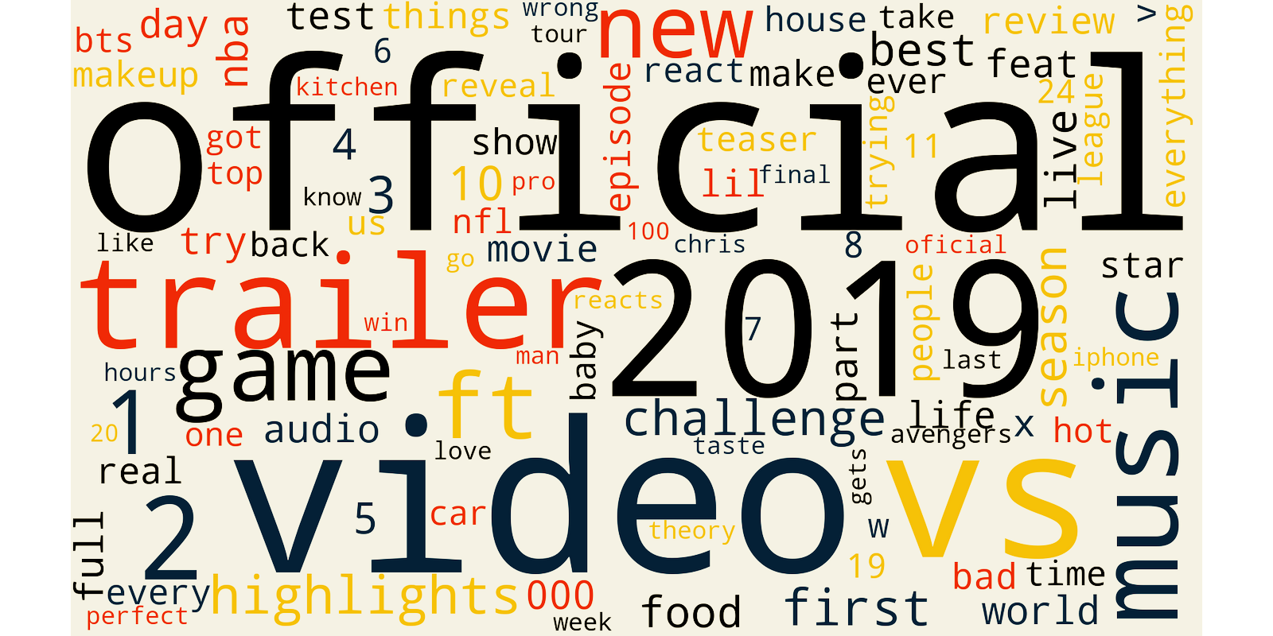
Word clouds
What are the most used words in trending videos titles?
What are the tags most used by Youtubers?
…?
Notes:
Aside from the probabilities tree, and previous mentioned methods, word clouds and a map are methods through which we will present our project

Slide 20
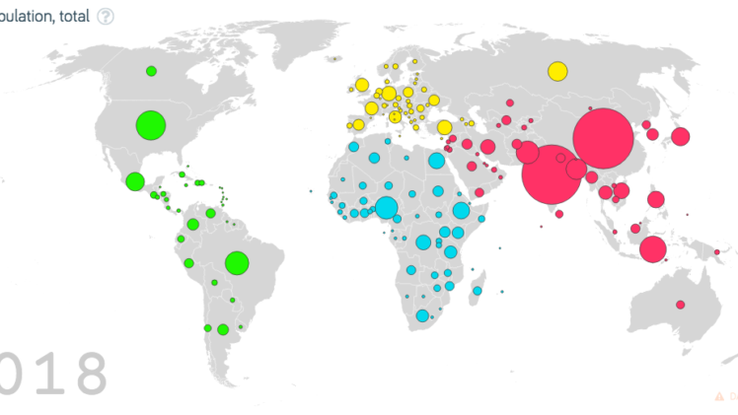
Map
→ To compare most frequent categories in trending page for different countries

Slide 21





the Team
Carla Barleaza
Data visualisation
George Linel
Programmer
Jorge Perez
Website director
Philippine Coutau
Researcher
Elisa Valentin
Editor

Slide 22
Q&A

Slide 23
Bibliography
Codega, L. (2020, January 30). What does it mean for a music video to go viral? Retrieved November 14, 2020, from https://shots.net/news/view/what-does-it-mean-for-a-music-video-to-go-viral#:~:text=Viral content happens when viewers,and are taken by surprise.
Moreau, E. (2020, September 24). What Does Going Viral Online Really Mean? Retrieved November 14, 2020, from https://www.lifewire.com/what-does-it-mean-to-go-viral-3486225
Staff, V. R. (2019, February 18). What Does "Going Viral" Mean? - "Gone Viral" Defined. Retrieved November 14, 2020, from https://www.verticalrail.com/kb/what-does-going-viral-mean/
Wynne, R. (2018, March 9). There Are No Guarantees -- Or Exact Statistics -- For Going Viral. Retrieved November 14, 2020, from https://www.forbes.com/sites/robertwynne/2018/03/09/there-are-no-guarantees-or-exact-statistics-for-going-viral/?sh=e4a69f75e8c9

